Slide 1
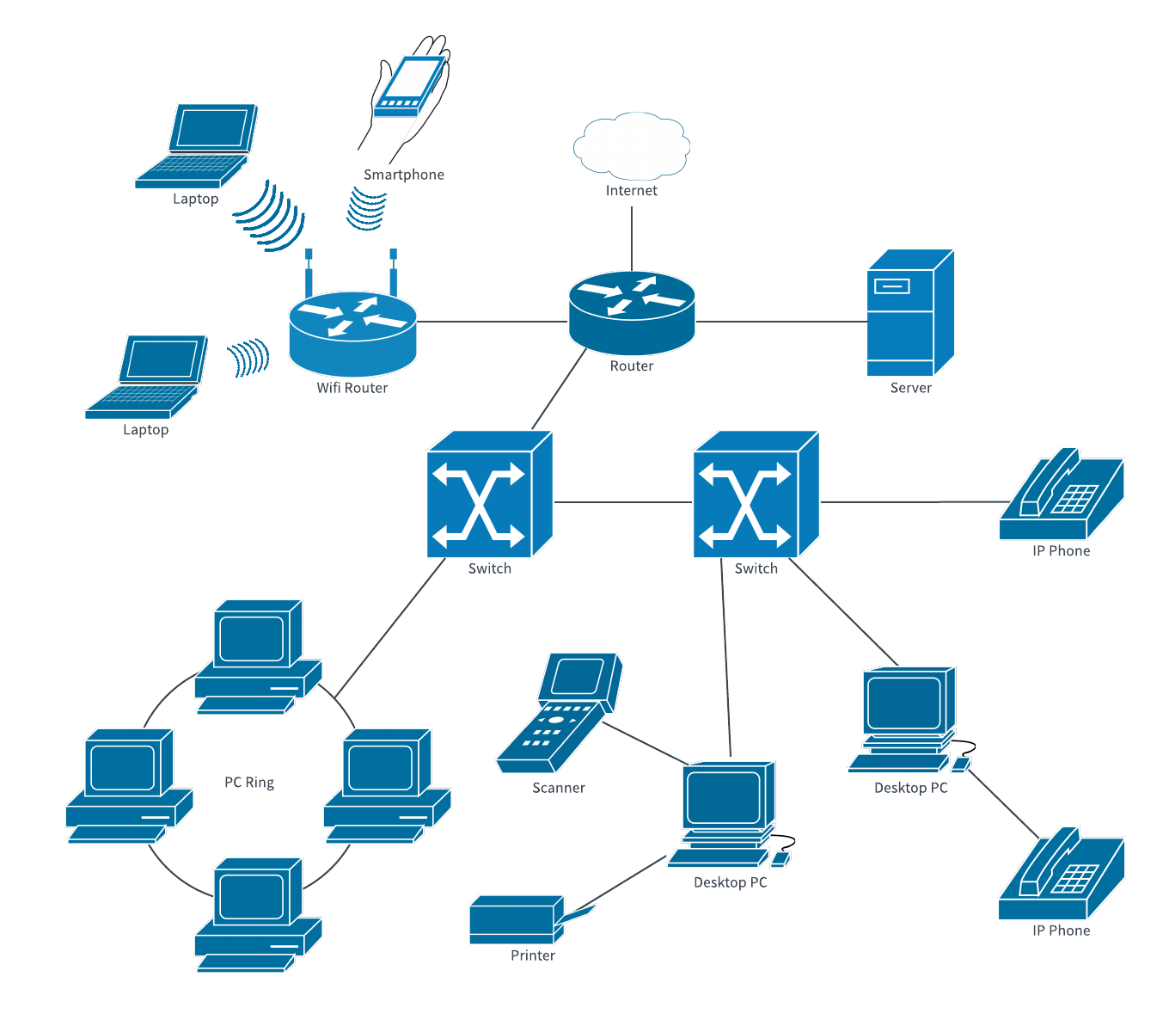
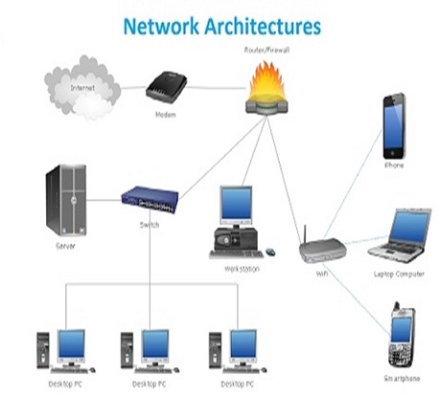
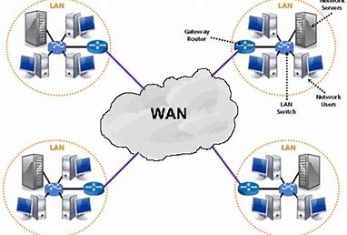
Internet Diagram
Vocabulary Words
How to Guide: Internet & Network
Internet- is a globally connected network system facilitating worldwide communication and access to data resources through a vast collection of private, public, business, academic and government networks.
Wide Area Network- A network used to connect computers over large geographical distances.
Local Area Network- A network used to connect devices within a small area.
Packet switches- is a digital network transmission process in which data is broken into suitably-sized pieces or blocks for fast and efficient transfer via different network devices.
Wireless network- A type of network that does not require the use of cables.
Telecommunications- The transmitting and receiving of data.
Network architecture- The structure of a network.
Cable Internet access- is a form of broadband Internet access which uses the same infrastructure as a cable television.
Internet Protocol- is the principal set (or communications protocol) of digital message formats and rules for exchanging messages between computers across a single network or a series of interconnected networks, using the Internet Protocol Suite (often referred to as TCP/IP).
Transmission rate- refers to the rate at which data is processed or transferred.
Communication links- is the means of connecting one location to another for the purpose of transmitting and receiving data.
Chiebuka Ahaghotu
November 21, 2020
CTEC 415 - 101
Network Architecture
Wide Area Network

